Slide 1
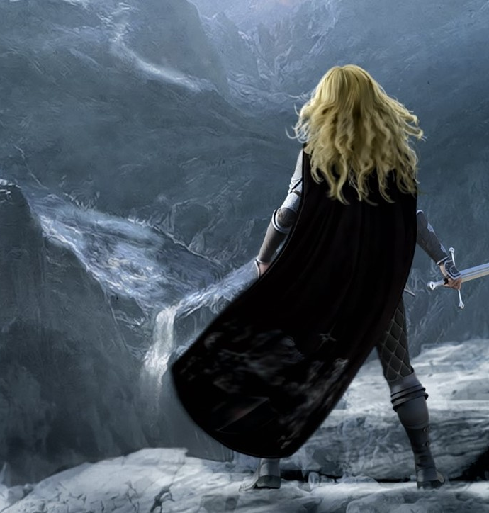
The Characters
Ivy is the main character. She is 14, loyal to her friends, brave, stubborn and deeply cares for her pets. She’s been trained in sword fighting and has magical powers.
Zack is a member of the Birds of Hope and is Ash’s twin. Her safety is very important to him. He has a chip on his shoulder and a short temper. He’s well trained in sword fighting.
Anthony is a member of the Birds of Hope. He is small but determined. He fights with a sword although not as well as he would like. He puts a lot of pressure on himself.
Who is your favourite character and why?

